Slide 1
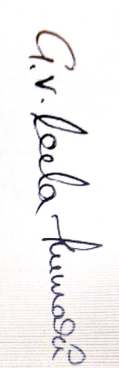

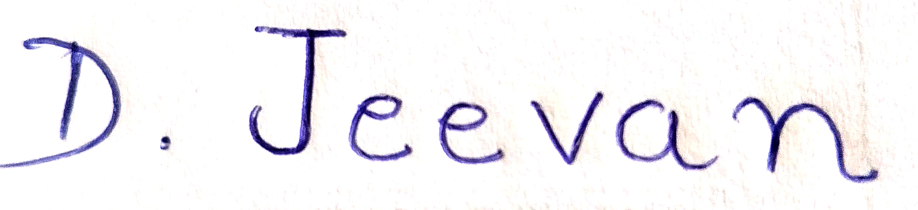
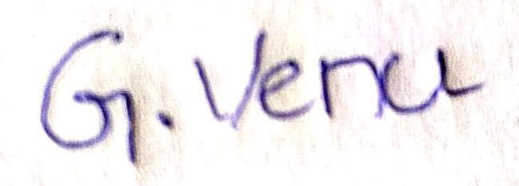
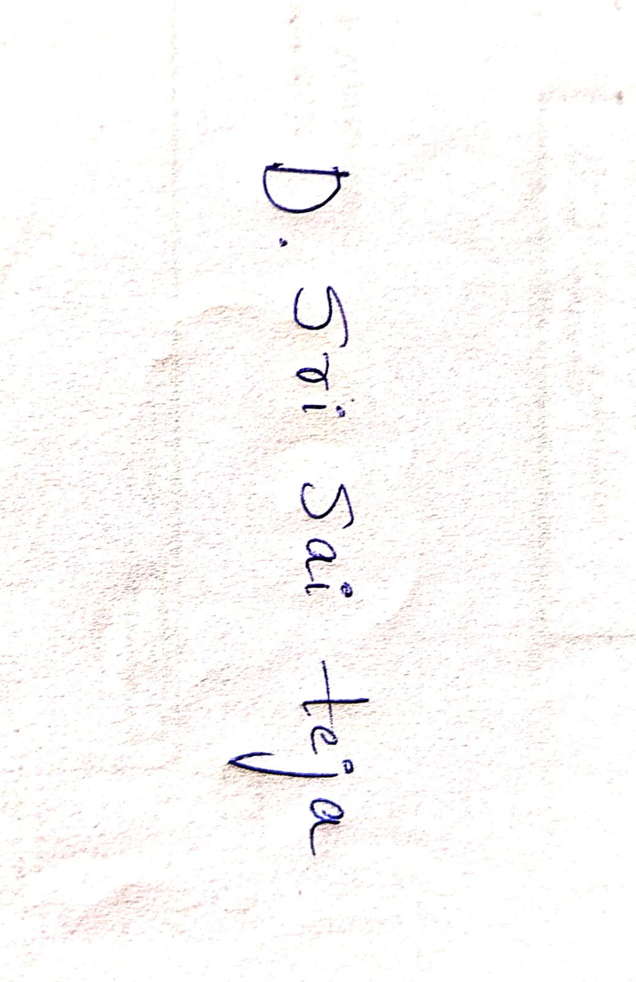

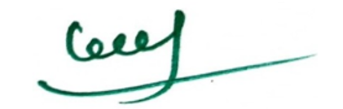
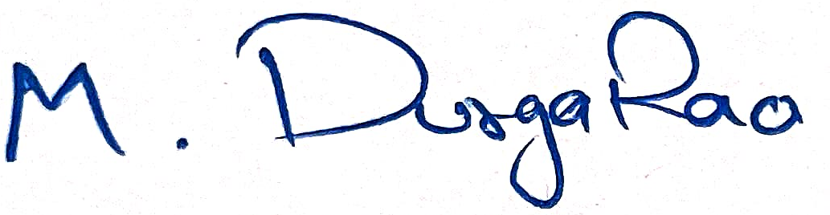
(Gavini Venkata Leela Kumari)
(Palaparthi Venkata Naga Srinivas)
(Gaddam Venu)
(Jeevan Devandla)
(Gulivindala Sri Lakshmi Sarojini)
(Doppalapudi Sri Sai Teja)
(Mudraboina Durgarao)
(Principal, Bapatla Engineering College)

